Slide 1



Data Analyst
PORTOFOLIO
Dio Obriiel Saragih
Binus University

Slide 2

ABOUT ME
Hi! I’m Dio Obriel Saragih, an active student at Binus University, majoring in Computer Science with a focus on Database Management.
I am passionate about data analysis and skilled in using Power BI and Microsoft Excel to transform raw data into actionable insights.
Beyond technical skills, I am a good communicator and a collaborative team player. I’m eager to keep learning and growing, particularly in the areas of data analytics and business intelligence, with the goal of delivering value-driven solutions.

Slide 3


EDUCATION
SMA Yadika 8
Binus University
2020-2023
2023-now
Strengthened logical thinking and problem-solving through mathematics and science.
Building skills in database management, data analysis

Slide 4







MY SKILLS & TOOLS
Data Analysis & Visualization
Power BI (Dashboard Creation, Data Visualization, Forecasting)
Microsoft Excel (Pivot Tables, Charts, Data Cleaning)
Database & Programming
Basic SQL
Python (Cleaning up duplicate data and missing data)
Soft Skills
Strong communication skills
Team collaboration
Problem-solving & critical thinking

Slide 5


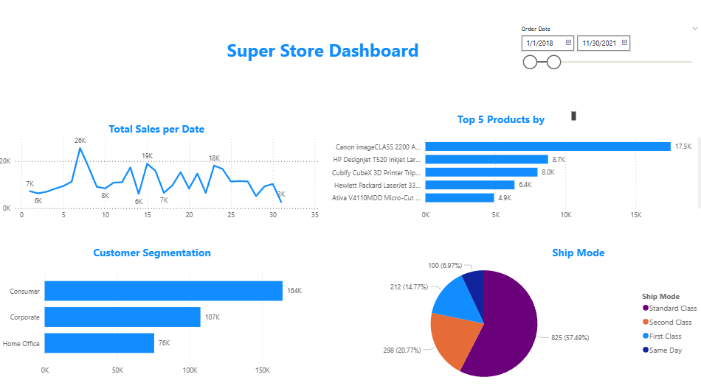

PROJECT PORTFOLIO
1. Total Sales per Date
The line chart shows fluctuating daily sales with peaks around 26K, 19K, and 18K during the selected date range (January 2018 – November 2021).
2. Top 5 Products
Canon imageCLASS 2200 is the best-selling product with 17.5K sales, far ahead of other products.
The second-best product, HP Designjet T520, has 8.7K sales, showing that Canon contributes a significant share of total revenue.
3. Customer Segmentation
Consumers contribute the largest share (164K), followed by Corporate (107K) and Home Office (76K).
This means retail consumers are the primary target market, and marketing strategies should focus on them to maximize revenue.
4. Shipping Mode
Standard Class is the most used shipping mode (57.49%), followed by Second Class (20.77%) and First Class (14.77%).
Same Day delivery is the least used (6.97%), which might indicate either high cost or low demand for urgent shipping.
Key Insights
Focus on Consumers: Most sales come from the consumer segment, so campaigns targeting them will likely boost revenue.
Top Product Dominance: Canon imageCLASS is a key driver — ensuring stock availability is critical.
Shipping Strategy: Standard class dominates; promoting faster delivery options (same-day or first class) might unlock premium customers.

Slide 6







LETS WORK TOGETHER
081381785863
dioobriel205@gmail.com
linked-in

Slide 7




Closing
THANK YOU

